Slide 1


How to … Study
Study skills and note taking

Slide 2

Why notes are important
Things you think you might forget
Things you don't understand and need to look up later
Writing things down helps put stuff into your memory
Handwritten vs Typed
Something to refer back to and can help job memory
Can help focus, including things like the action of writing something down to help you stay in the moment
Make connections you didn't see at first
Things you didn't realize were important at the time but actually are once you know more
Can be used as prep work for future assignments and classes, such as writing a paper or doing lab work that needs previous knowledge

Slide 3
Sketch notes
This is a combo of words, doodles and visuals
This is designed for people that are very visual
If you enjoy doodling or visually impressive notes this might be for you
Doodling can improve focus in some people
Artistic ability not required
This can also include things like boxes and highlights, colours, and other ways to distinguish high level concepts or headers
Basic technique is having a header for the page (overall topic), then write/sketch your ideas and what comes to mind as you read/listen
Try it with something new or an article for a quick way to see if you like it

Slide 4
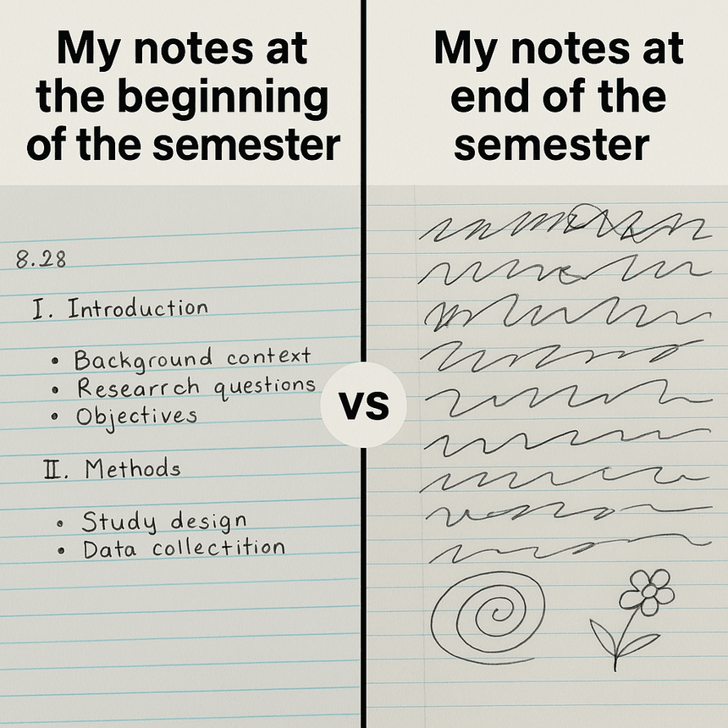
Outline form notes
Can be informal, use indents but doesn't have to have full outline (such as all 1 must have 2)
Use the format of an outline
Nest idea to make visualizations easier
Uses heading and sub headings to organize your thoughts
Doesn't need to be perfect, this can be a working document and you can make changes later
You can also do things like take notes and then reorg into an outline to make the knowledge more organized in a way that works for you
Try it with something new such as an article or video to see if you like this

Slide 5

Audio notes
If you process information better using audio you can do things like record classes (with permissions)
Take notes and have a computer or friend read it out and record
Have your textbooks read to you using the computer or a friend (again be careful with permissions and legality)
Some people also process better when talking so you can record yourself talking through problems (this can be a good use of an AI)
Use an AI that has voice capabilities as a way to bounce ideas and remember your train of thought

Slide 6
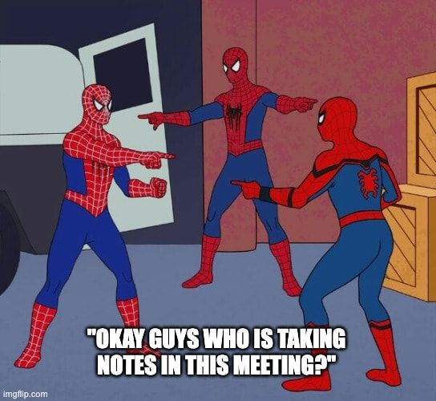
Study groups
Can be informal or formal
You can share notes together to see if anything was missed, or important concepts weren't understood
Explaining a concept to someone else really tests your knowledge
For some people having a scheduled meeting time can be good for accountability
You can also talk to others about how they study and see if you want to change your study habits
See what other people find important and relevant to see if you missed anything or you like the way they take notes
It can be a way to feel less alone and less isolated
Sometimes it can feel like you're the only one that doesn't get it even though you probably aren't
Be careful when picking your group so that everyone is a good match and no one is too ahead or behind ( you don't want to spend the whole time explaining to everyone, or be the one that understands nothing the rest of the group is discussing)

Slide 7
How to read articles/books quickly
Scanning for keywords or concepts
Look at the first sentence of a paragraph as that is usually what the paragraph is about
Make use of table of contents/index/Ctrl-F to find the part you need
For articles look at the abstract to see if it's relevant and potentially save yourself some time
Figure out what you need to know and already know and focus your reading on the part you need
You can skim articles and books to find information or decide if it's relevant before reading thorough for comprehension

Slide 8
Accessibility in notes
If you need to share with others it's important to make sure you have good notes
Typing vs hand writing can be a difference in how easy they are to understand
Short hand unique to you can be hard for others to understand
Having digital notes can be easier to convert for other people (Such as having them read out loud by a computer or person)
AI can be a help with accessibility because it can do things like transcripts of recordings or summarize things for you, (WARNING AI is not always right)
Think about other ways to visualize info such as flowcharts or infographics

Slide 9
Notetaking software suggestions
Obsidian
Free to use with a paid option to sync and backup
You can make your additions
Can be tough to learn
Goodnotes ($)
Costs money, but very popular for notes so there are lots of tutorials out there
Has lots of colour coding and design options
Notion ($)
Minimal design, and there is a free version with limited features
Lots of documentation and tutorials
OneNote
Almost everyone has free access
Can be setup to make drawings/doodles or outlines
Lots of tutorials

Slide 10
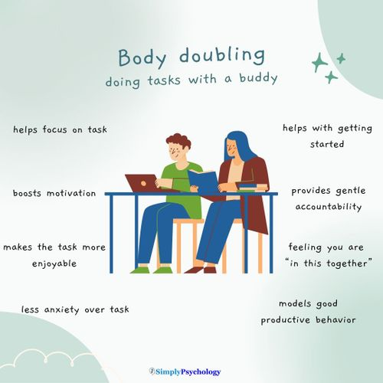
Offbeat suggestions
Body Doubling
Literally just working near another person or on the phone with another person
Doesn't need to be someone in your class/major/school
Used as a way to keep yourself focused
Check-ins for accountability
Doesn't need to be someone in your class/major/school
Check-ins can be as frequent or infrequent as you want
Listen to or watch things related to the topic in other situations such as driving, riding public transit or even as you go to sleep
https://www.simplypsychology.org/adhd-body-doubling.html

